Slide 1
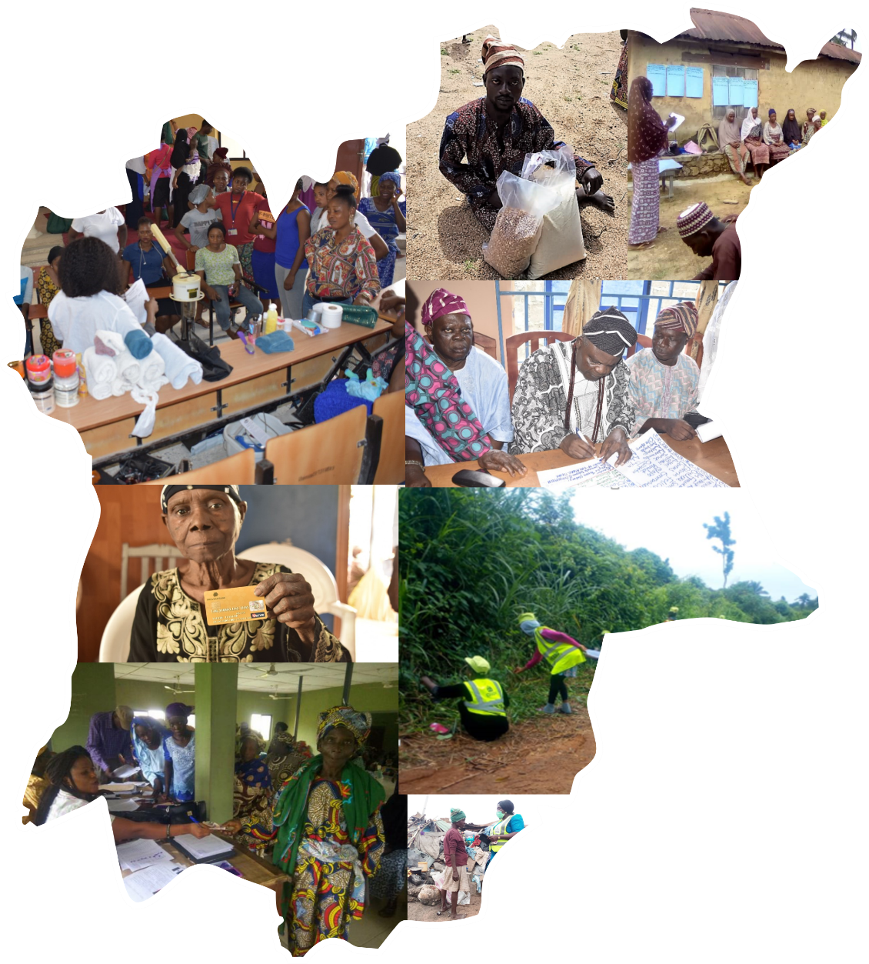
State Operations Coordinating Unit,
National Social Safety Net project (NASSP),
Ministry of Economic Planning, Budget and Development
594,430
1,291,245
696,815
Male
TOTAL
feMale
ADDRESS-
Plot 3&4 Yemi Ajijolaiya Street, G.R.A. Oke-fia, Osogbo, Osun State, Nigeria.
E-mail-
osunsocu@nassp.gov.ng
Tel-
08034990980, 08055567037

Slide 2
Who We Are
The State Operations Coordinating Unit (SOCU) is the coordinating office of the National Social Safety Net Projects (NASSP) in the Sate.
It is an agency under the Ministry of Economic Planning, Budget and Development that collects and warehouse demographic, welfare, employment and assets data of Poor and Vulnerable household in Osun State. SOCU also collects data of community amenities and infrastructure such as health care facilities, access to electricity, access roads, access to banks, and available GSM networks, which are mainly used for policy-making.
The data collection started in 2014 using tested and globally accredited targeting methods such as geographical targeting, Community Based targeting (CBT), and Proxy Means Tests.
Where We Started
NASSP is an offshoot of the Youth Employment and Social Support Operation (YESSO).

Slide 3
Project Development Objective
To expand coverage of shock responsive safety net support among poor and vulnerable and strengthen the national safety nets delivery system
Specific Objectives
Strengthening and coordinate the Social Safety Net System (SSN) in the State.
Assist government in consolidating the institutional responsibilities and implementation arrangements on social protection system.
Manage a central platform that consists of a targeting system (Community Based Targeting), a register of poor and vulnerable households and individuals , as well as a monitoring and evaluation system

Slide 4
SOCU Mandate
Strengthen and Coordinate the Social Safety Net System in the State through collection and warehousing of data of poor and vulnerable across communities in the State and identifying potential beneficiaries based on their poverty levels.
Assist government in consolidating the institutional responsibilities and implementation arrangements on social protection system by partnering with implementation agencies

Slide 5
TARGETING MECHANISM AND DATA MINING PROCEDURES
Targeting Mechanism
Data Mining

Slide 6
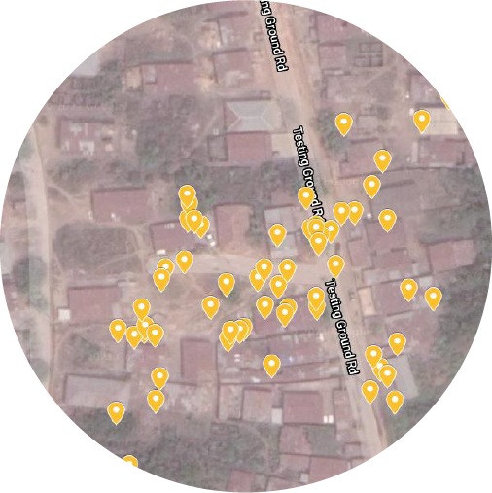
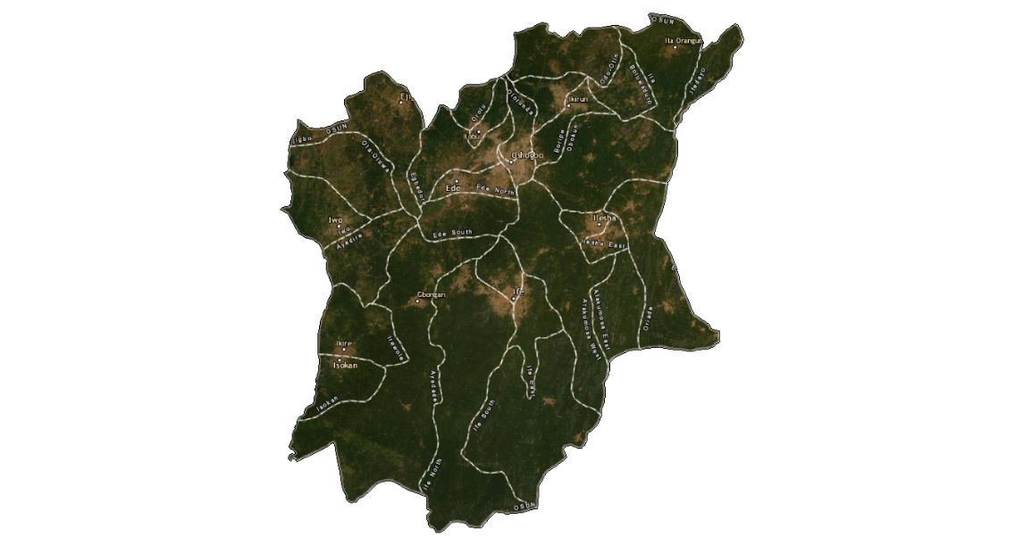
National Social Register (NSR) and State Social Register (SSR) built through the combination of three Targeting Mechanism:
ALAPININI COMMUNITY – ISOKAN LGA
1.GEOGRAPHICAL TARGETING
2.COMMUNITY BASED TARGETING
3.PROXY MEANS TEST
RANKING
OUTPUTS
LISTS OF RANKED
COMMUNITIES IN ALL LGAs
LISTS OF POOR AND VULNERABLE HOUSEHOLDS
RANKED LISTS OF
POOR HOUSEHOLDS

Slide 7
SUMMARY: STATISTICS
National Social Register (NSR) and State Social Register (SSR )Status as at June, 2024
NSR
774 LGAs
30 LGAs
SSR
8,000+ Federal Electoral Wards
332 wards
228,224 Communities
7,794 Communities
19,393,195 Households
354,642
Households
68,719,895 Individuals
1,291,245
Individuals

Slide 8
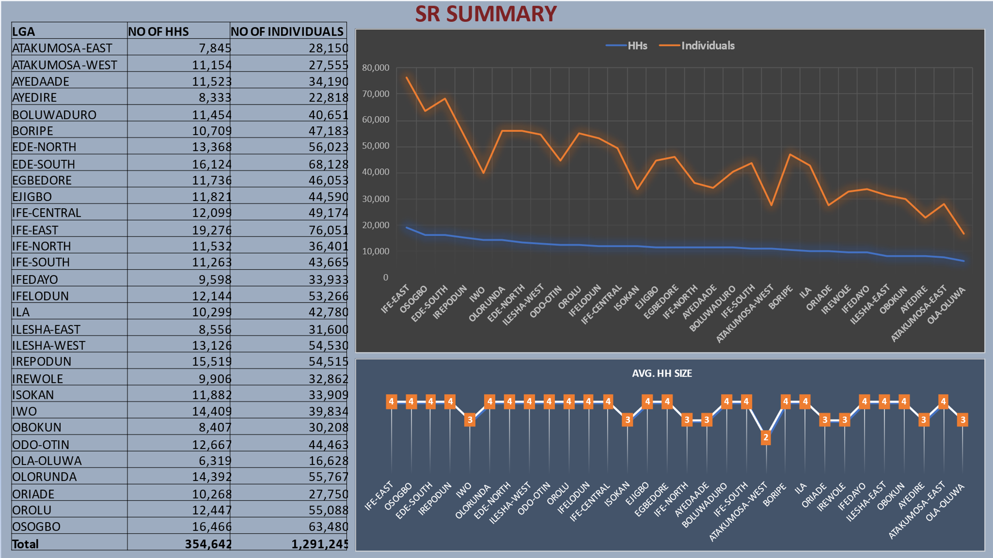
Notes:
We have hit 1 million

Slide 9
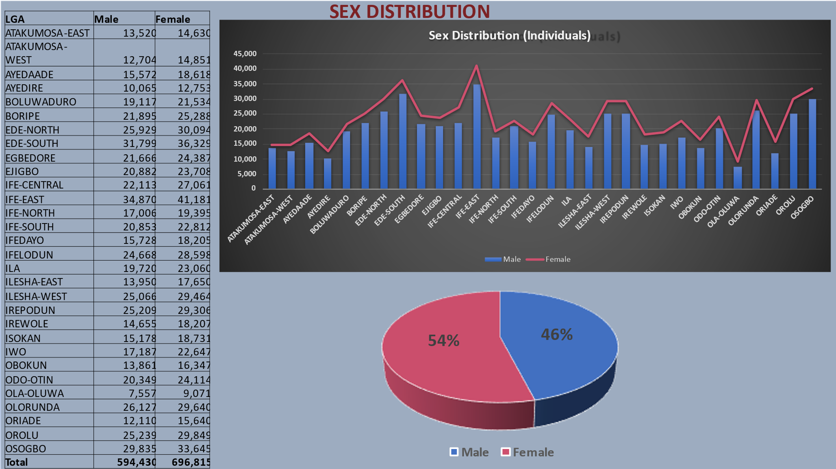
Osun State Operation Coordinating Unit (SOCU)
Notes:
We have hit 1 million

Slide 10
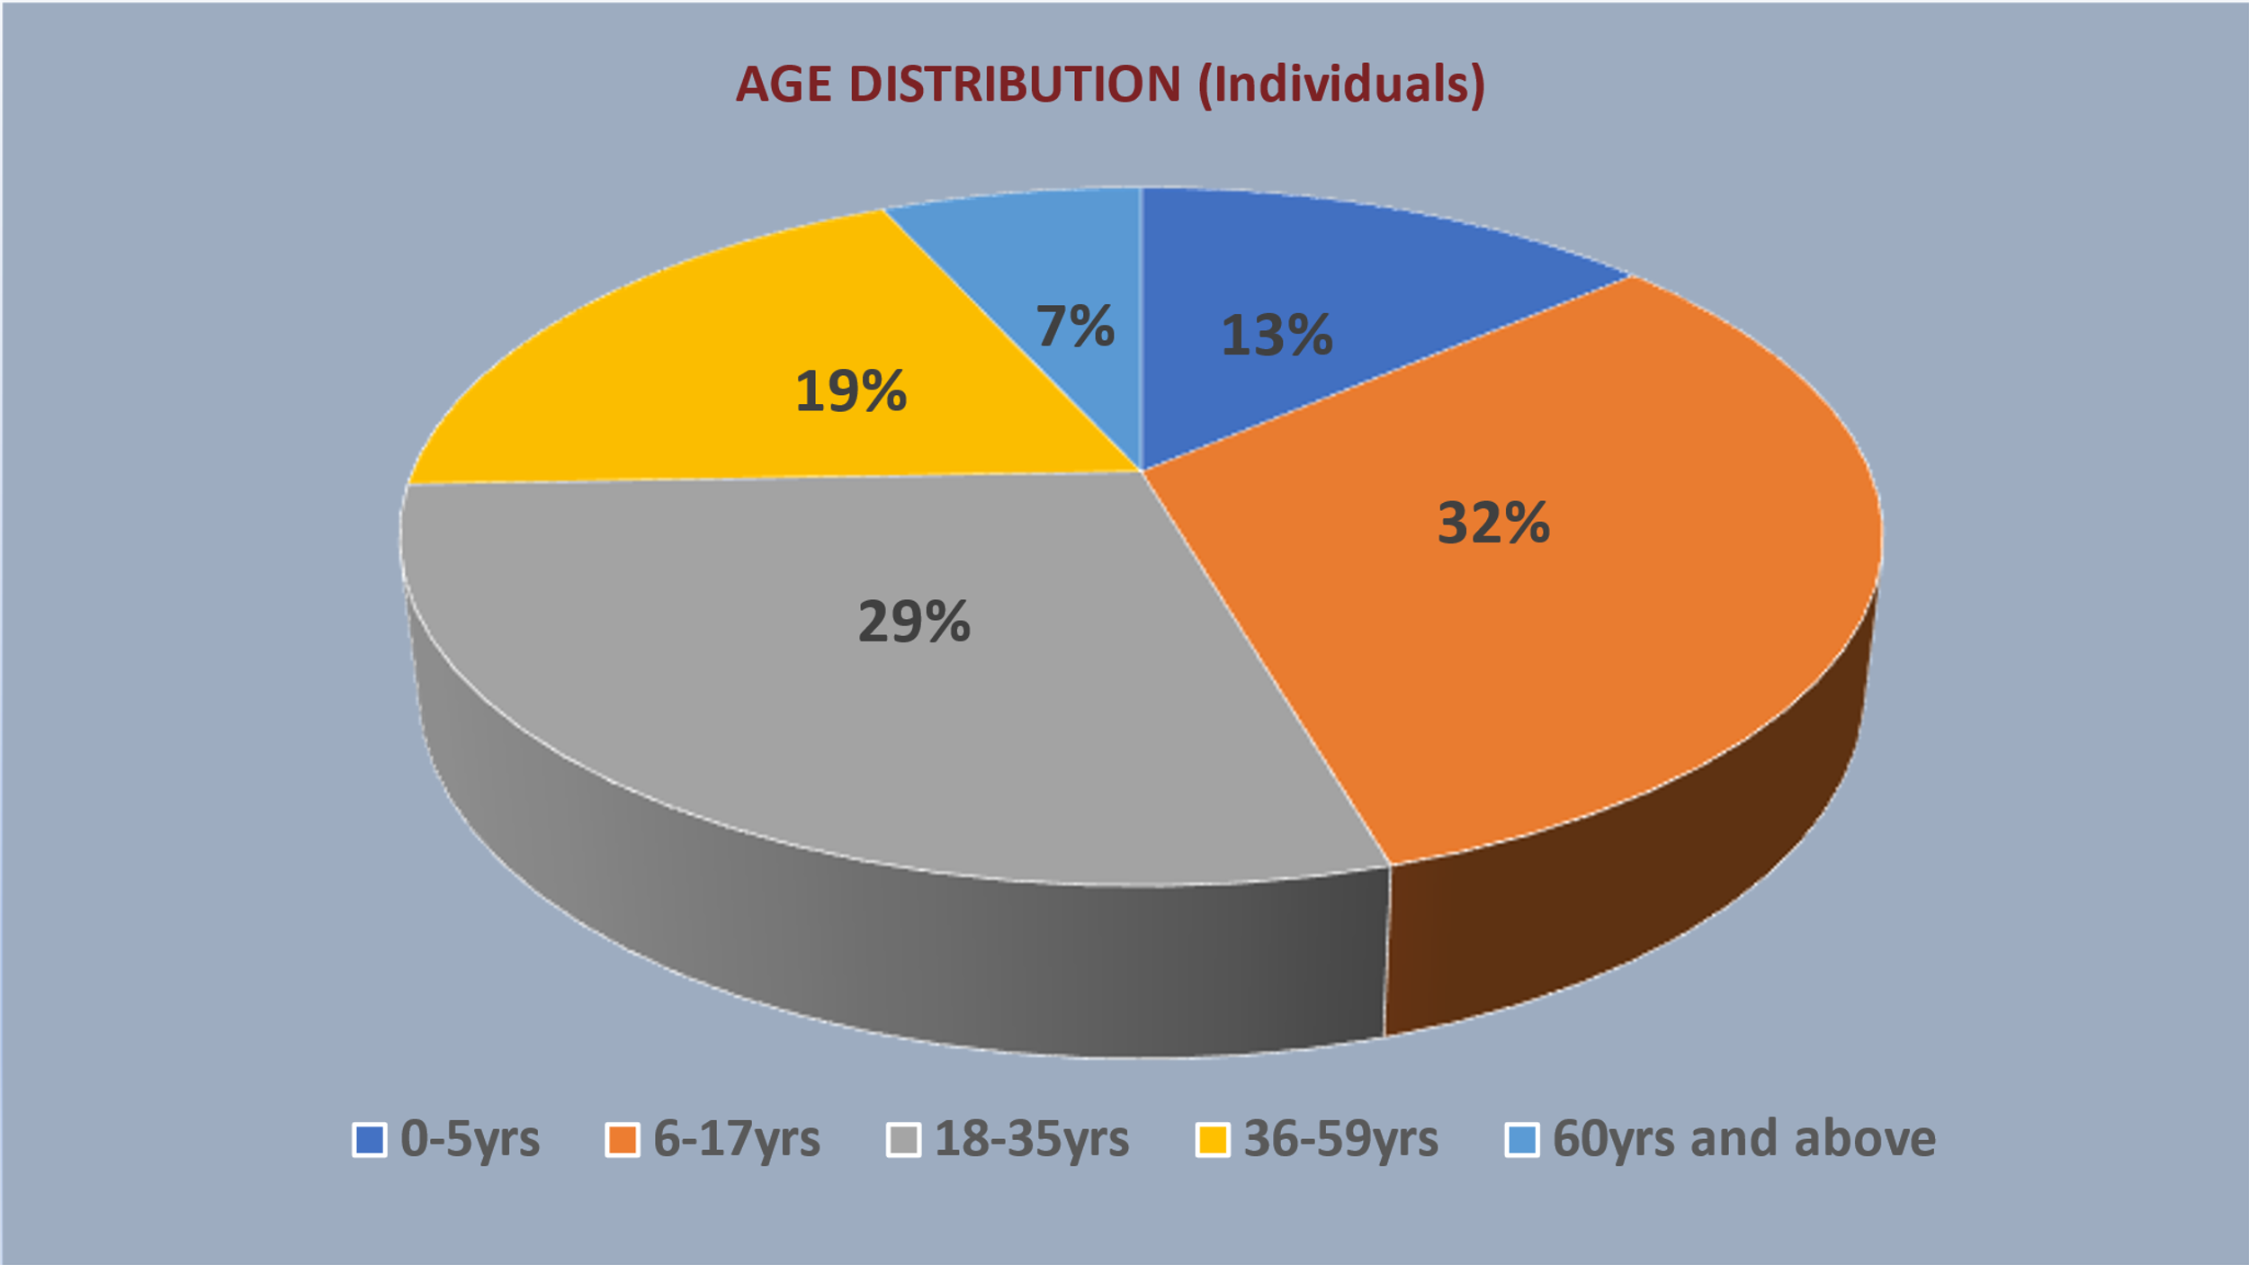
Distribution SSR by Disability
99.72%
100%
0.28%
1,287,675
1,291,245
3,570
Notes:
We have hit 1 million

Slide 11
CONTRIBUTION OF SOCU TO GOVERNANCE IN OSUN STATE THROUGH SSR.
It provides a platform for planning and implementation of social protection policies in the state e.g. Osun Food support Scheme, Osun State Cash Grant Scheme, COVID-19 Food Relief and Palliatives, Free Health Insurance Scheme.
It attracts funds to the state through Development Partners programs and interventions e.g UNDP, World Bank, ILO, UNICEF e.t.c
It provides database for Federal Government Social Protection Programs e.g. OSUN CARES, Renewed Hope Cash Grant, Conditional Cash Transfer etc.
PVHHs and Community Checklists Database could be used to negotiate with International Donors to provide support for the policies and programs of governments.

Slide 12
PROGRAM IMPACT
16, 624 households from the State’s Social Register have benefitted from Cash Transfer.
15,397 aged/physically challenged benefitted from the SR benefitted from YESSO’s Special Grant Transfer
11,835 unemployed youths selected from the SR benefitted from Youth Employment and Social Support Operation (YESSO) Public Work Fare programme
1,811 unemployed youths from the SR benefitted from YESSO’s Skills for Job.
21,695 poor households from the SR benefitted from the State’s COVID-19 food relief programme.
60,086 households from the SR are benefitted from the State’s Cash Grant and Food relief for the aged.
The introduction of RRR and its implementation has positive effects on the beneficiaries in reducing the effects of incidence of COVID 19 scourge.
19,720 residents of Osun benefited from Rapid Response Register Cash Transfer
47,260 benefited from Federal Government Cash Grant Scheme

Slide 13
FUND INJECTION TO THE STATE THROUGH STATE SOCIAL REGISTER
S/N | INTERVENTION | FUND DISBURSED TO BENEFICIARIES IN THE STATE
1 | Special Grant Transfer (SGT) | N1,231,760,000.00
2 | Conditional Cash Transfer Program (CCTP) | N3,989,760,000.00
3 | Public Workfare | N5,325,750,000.00
4 | Skills for Job | N393,892,500.00
5 | Federal Government Cash Grant | N1,181,500,000.00
6 | Rapid Response Register (RRR) Cash Transfer | N588,105,000.00

Slide 14
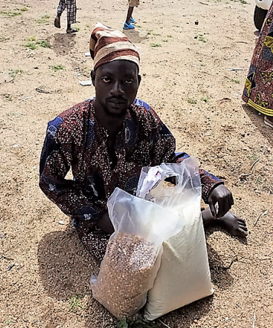
FOOD RELIEF AND PALLIATIVE
LGA | COMMUNITIES | HOUSEHOLDS
ATAKUMOSA EAST | 60 | 677
ATAKUMOSA WEST | 60 | 625
AYEDAADE | 60 | 635
AYEDIRE | 60 | 840
BOLUWADURO | 60 | 742
BORIPE | 60 | 698
EDE NORTH | 60 | 671
EDE SOUTH | 60 | 732
EGBEDORE | 59 | 765
EJIGBO | 30 | 697
IFE CENTRAL | 60 | 724
IFE EAST | 60 | 724
IFE EAST AREA OFFICE | 60 | 692
IFE NORTH | 30 | 604
IFE SOUTH | 60 | 700
IFEDAYO | 30 | 704
IFELODUN | 61 | 665
ILA | 60 | 750
ILESA EAST | 60 | 673
ILESA WEST | 60 | 684
IREPODUN | 60 | 744
IREWOLE | 60 | 683
ISOKAN | 30 | 684
IWO | 60 | 541
OBOKUN | 59 | 699
ODO OTIN | 60 | 681
OLA OLUWA | 60 | 713
OLORUNDA | 31 | 704
ORIADE | 56 | 662
OROLU | 60 | 691
OSOGBO | 62 | 891
TOTAL | 1708 | 21695
A food support targeted at households with People With Disabilities (PWD) households with members that are chronically ill, households with Aged head, households with Widows as heads and households not currently benefitting from any social safety net programmes

Slide 15
PICTURE SPEAKS

Slide 16
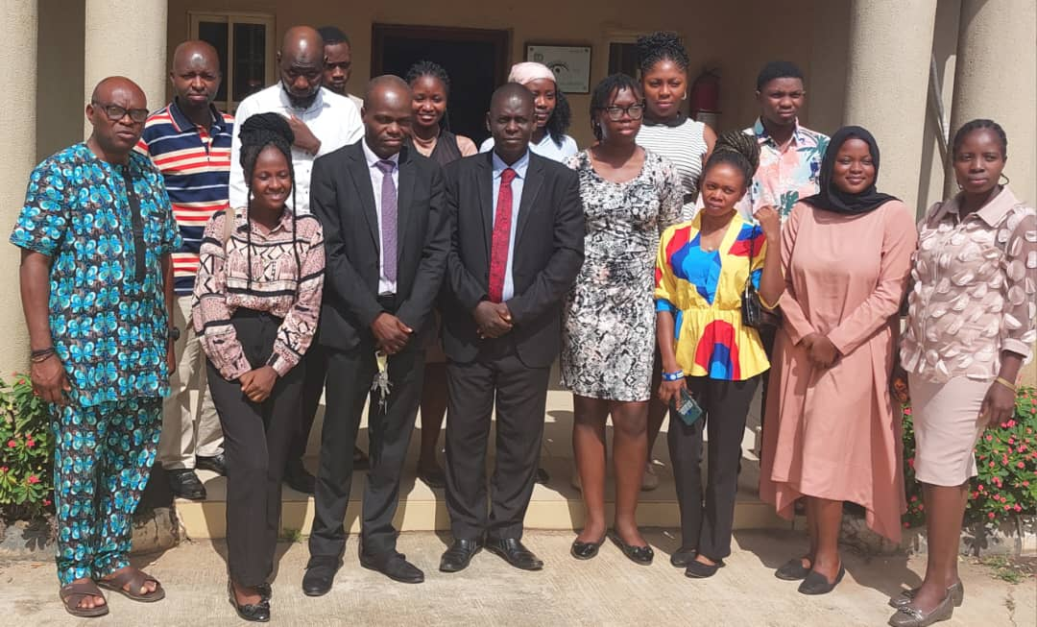
VALUE FEMALE NETWORK (VFN) COLLABOORATES WITH SOCU
VALUE FEMALE NETWORK (VFN) COLLABORATES WITH SOCU

Slide 17
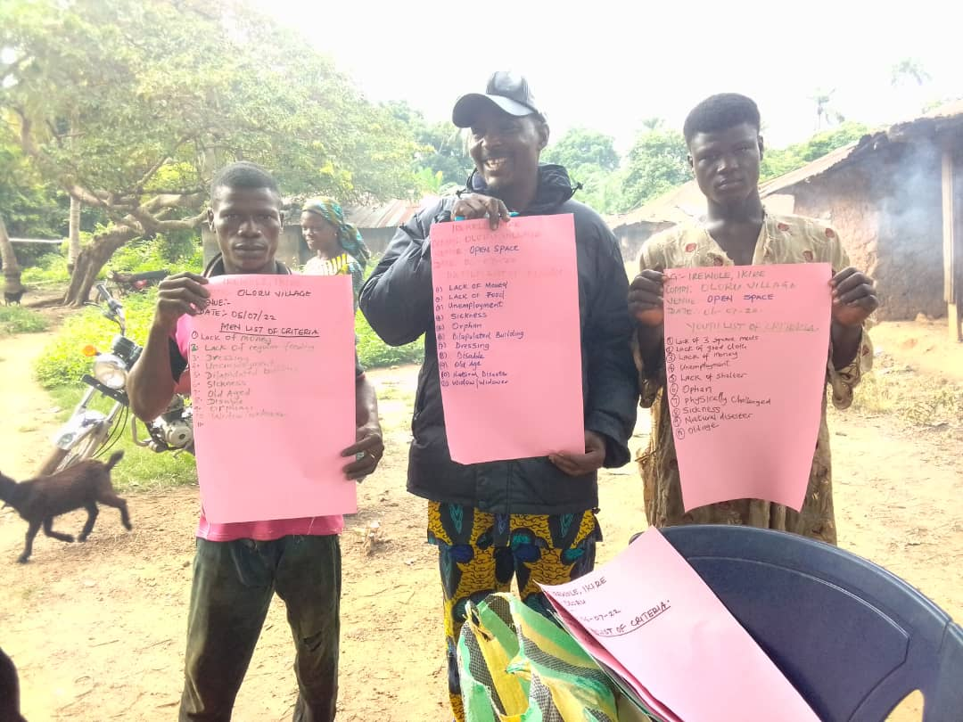
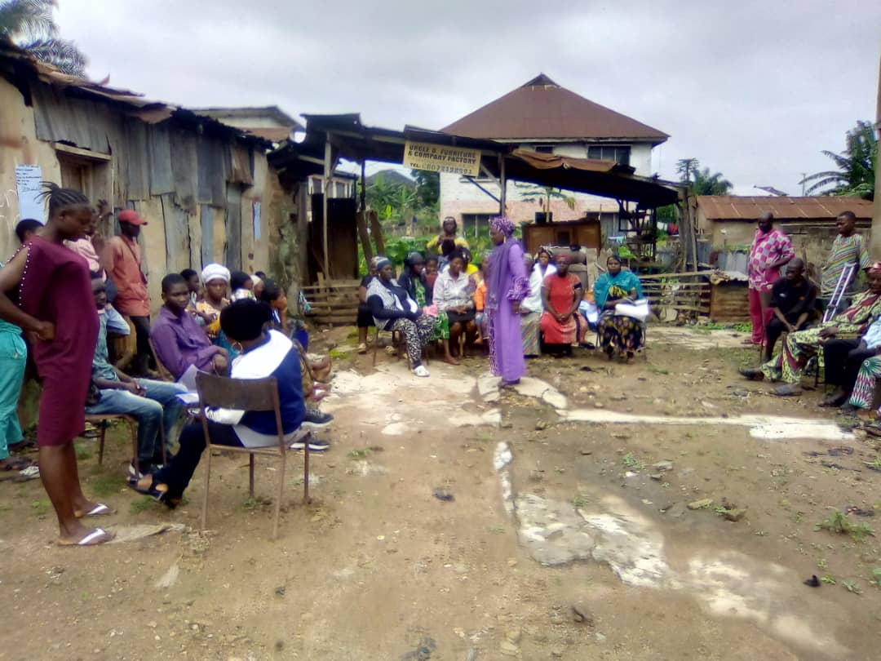
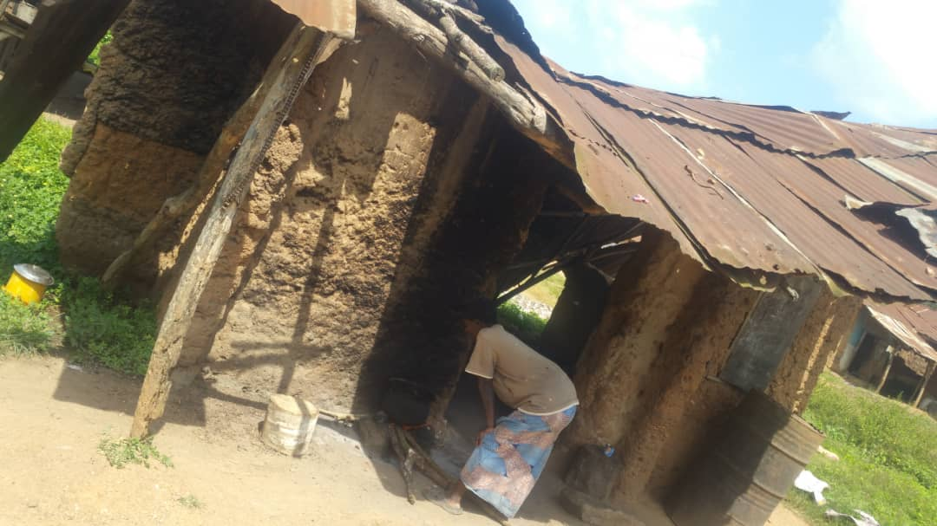
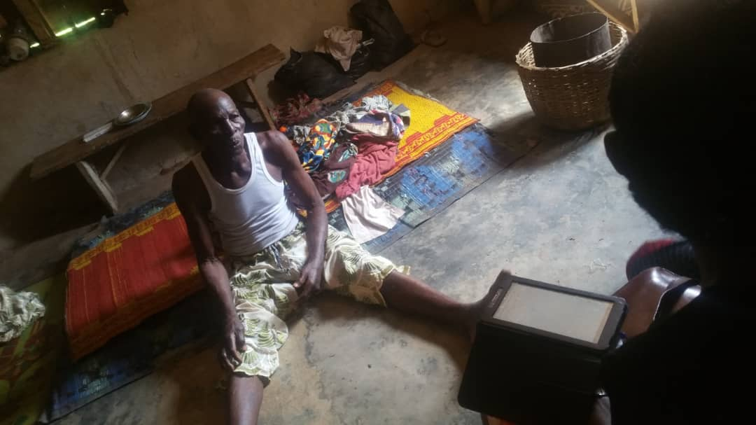
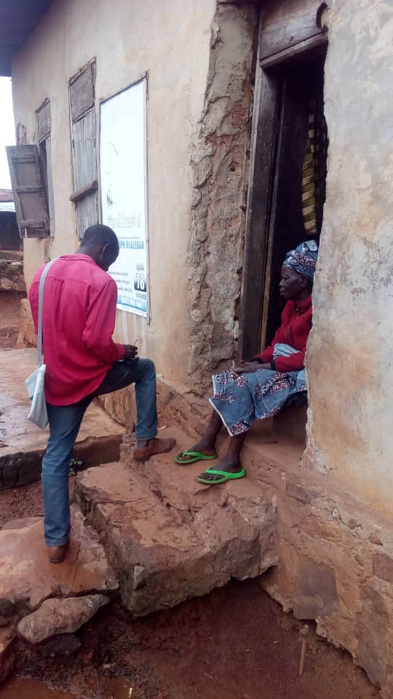
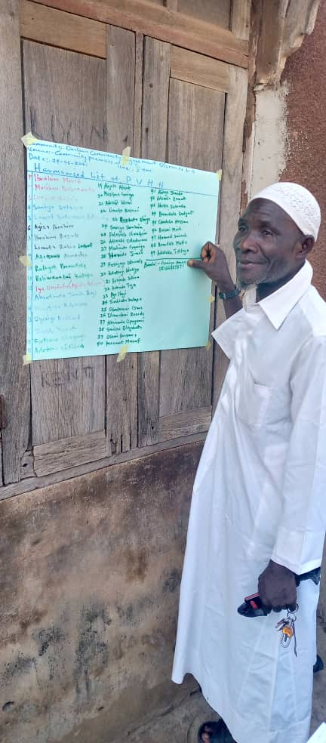
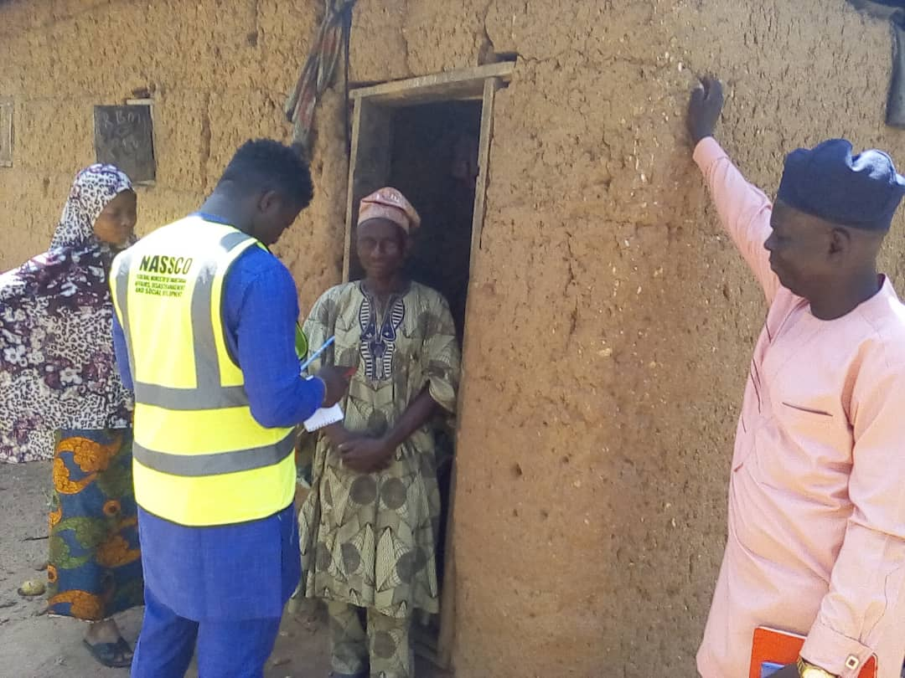
HARMONISATION OF GROUP LISTS
FOCUS GROUP DISCUSSIONS
TYPICAL DWELLING CHARACTERIZATION
POTENTIAL BENEFICIARY
DATA CAPTURING
COMMUNITY LEADER THUMB PRINTING THE FINAL LIST
STATE COORDINATOR MONITORING OF THE ENUMERATOR

Slide 18
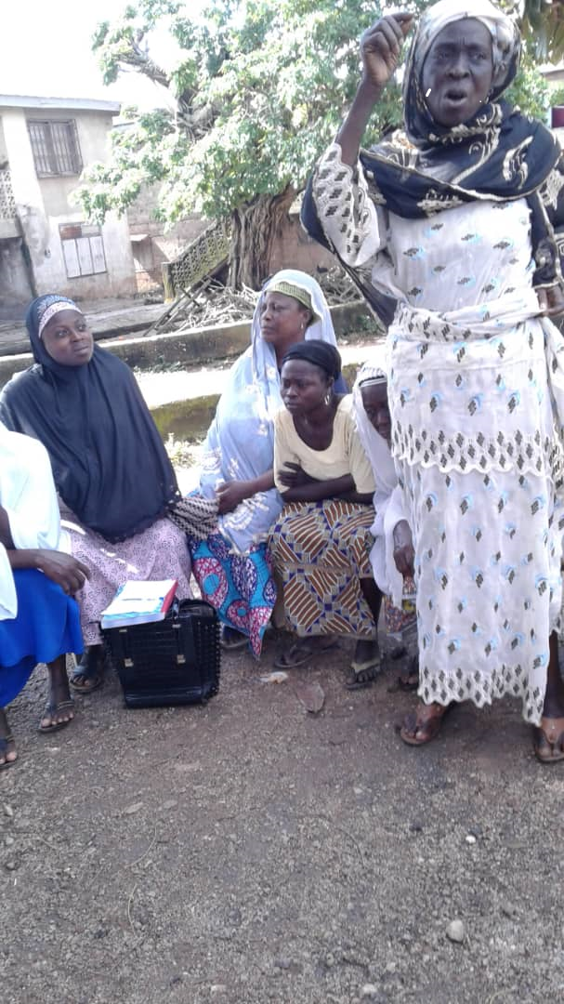
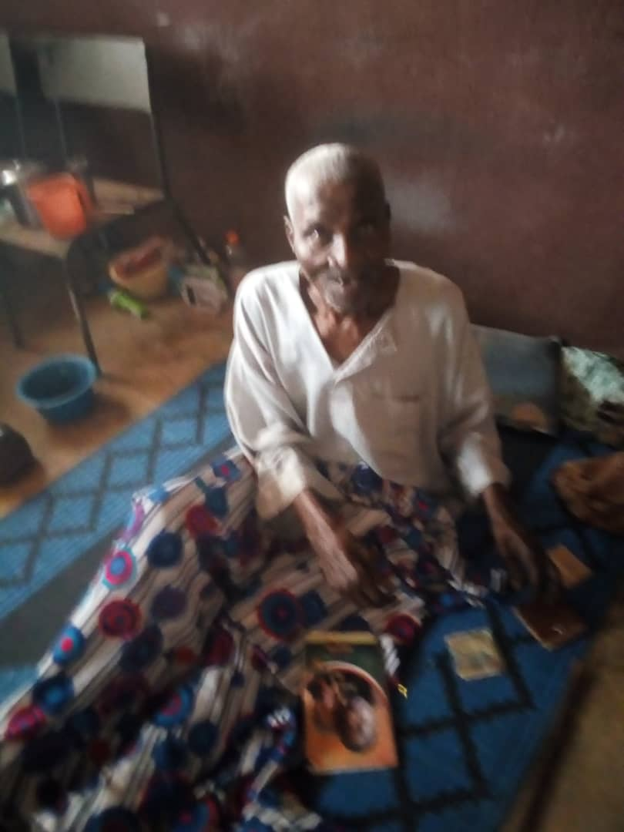
POTENTIAL BENEFICIARIES

Slide 19
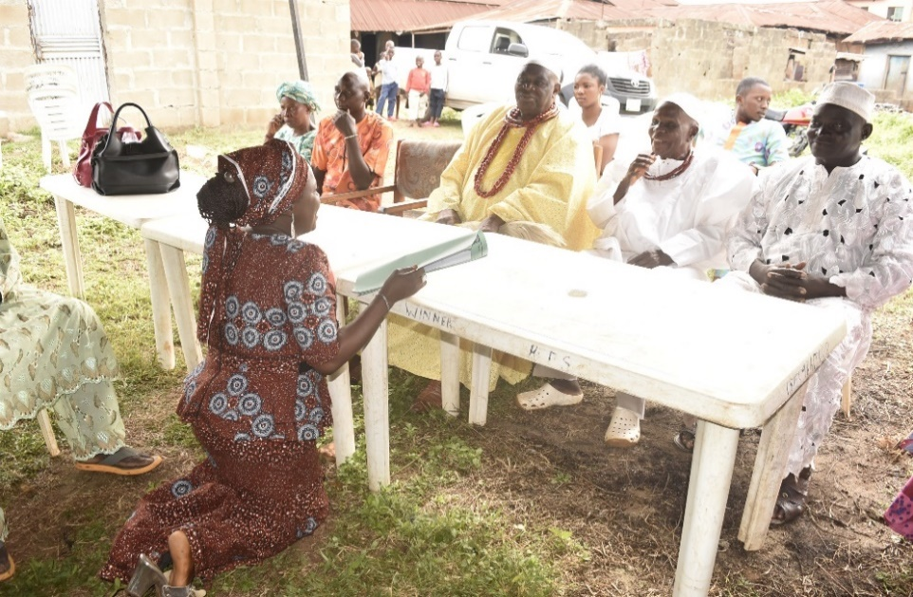
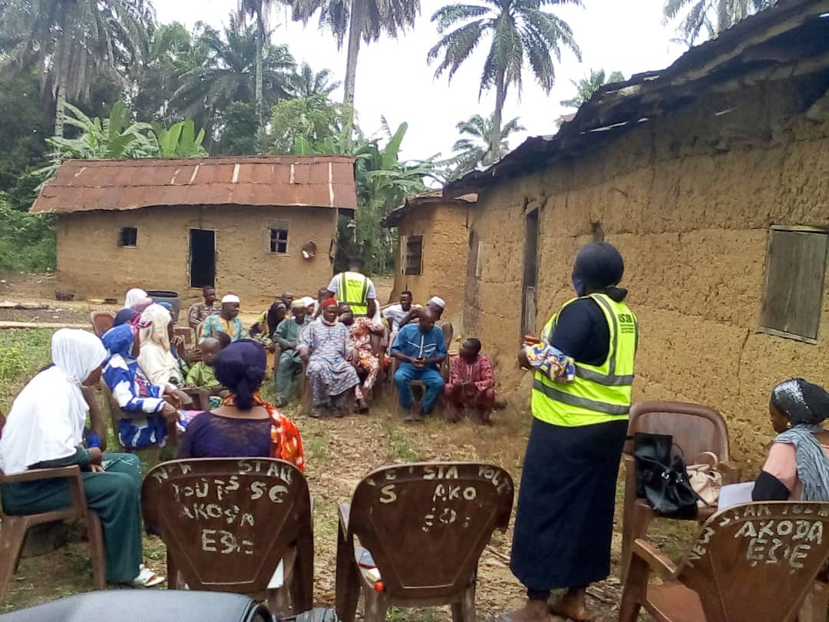
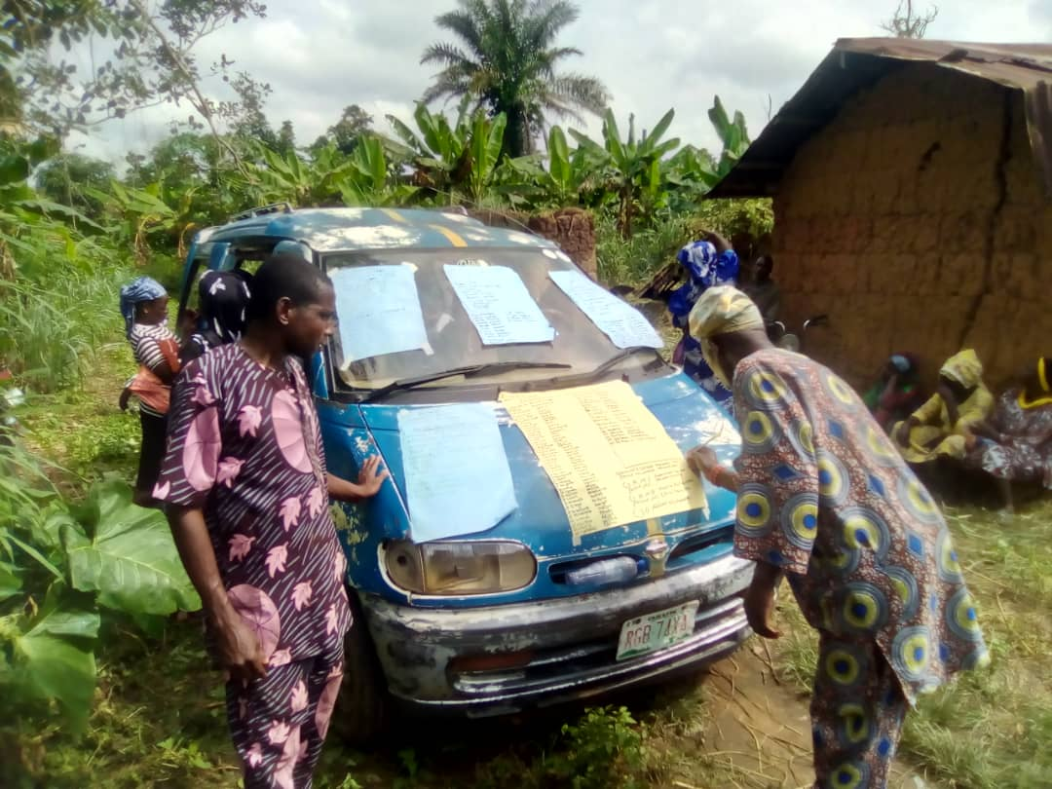
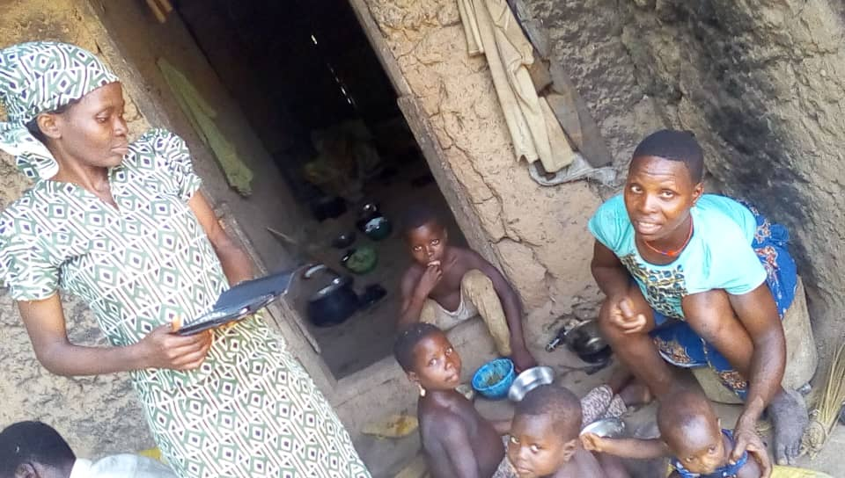
COMMUNITY BASED TARGETING PROCESS
Sensitization & Mobilization
Community Engagement
The final list is signed by community leaders (male & female) and LG Desk Officers before data collection
Data captured on field are transmitted electronically to the designated server

Slide 20
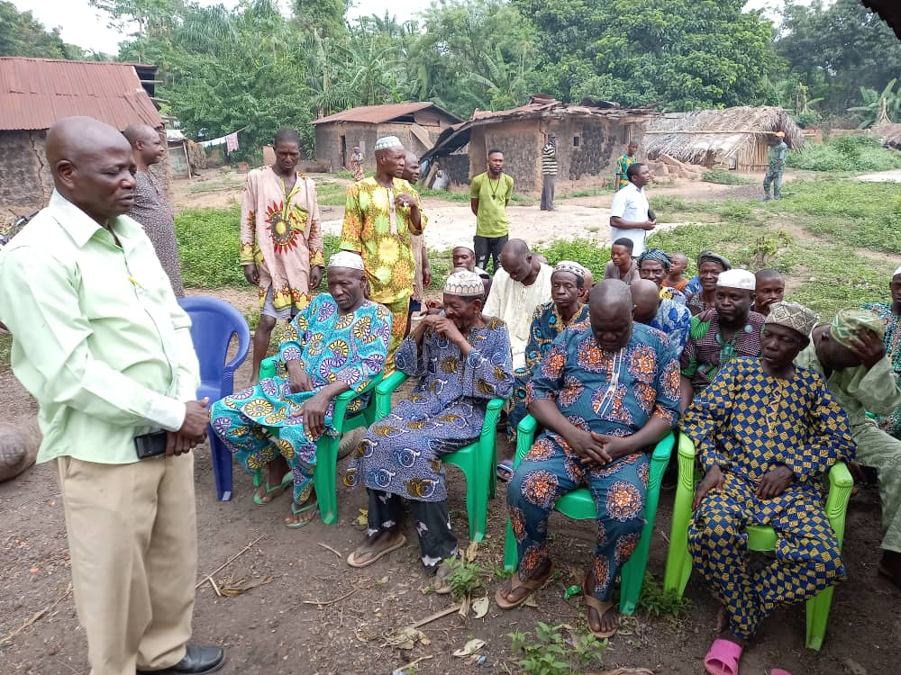
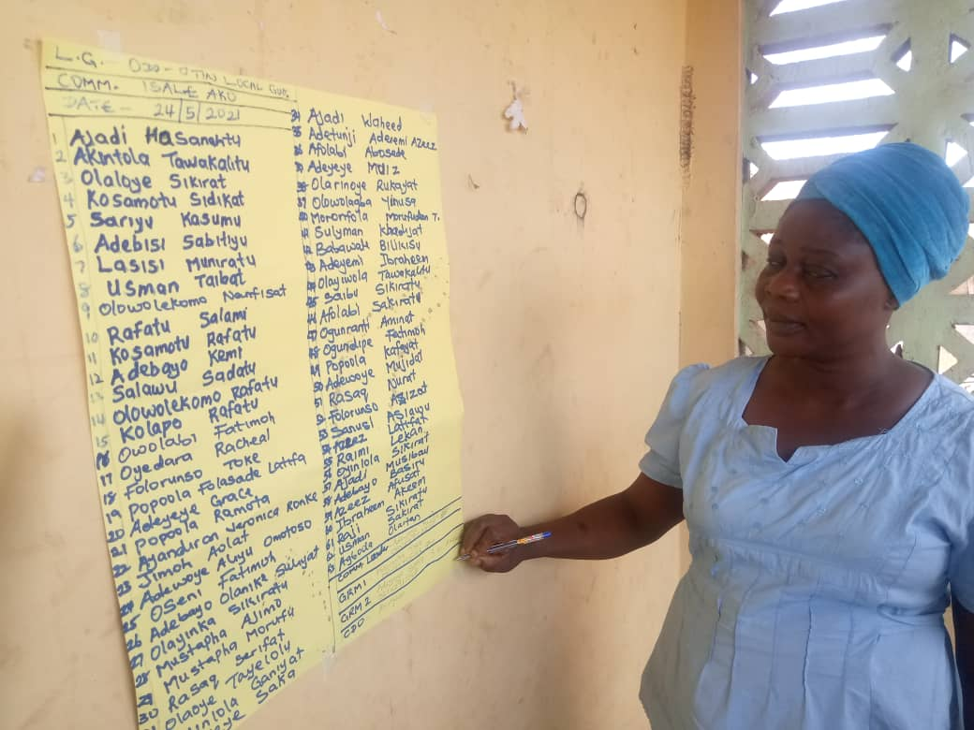
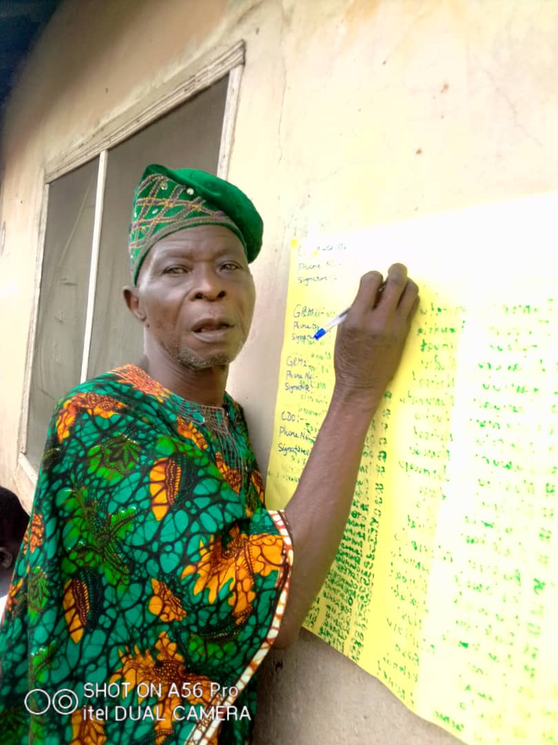
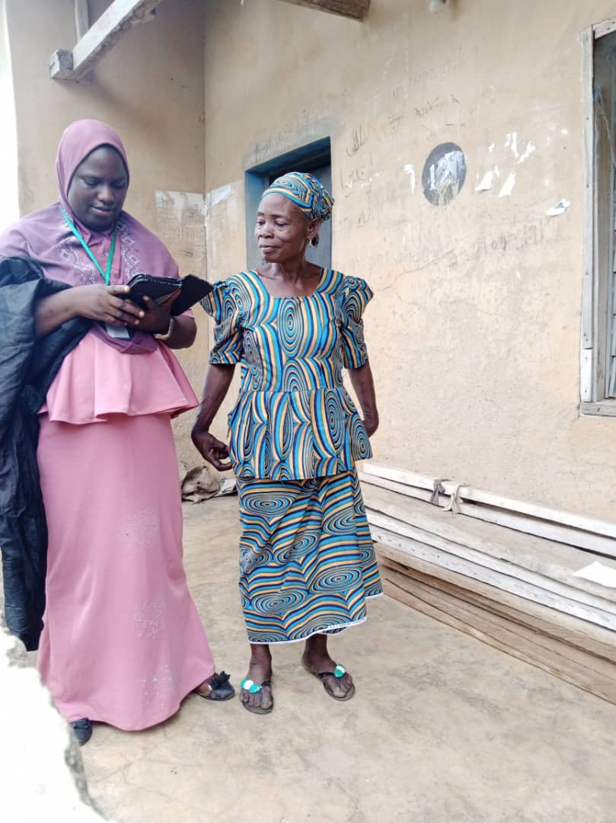
MEN FOCAL GROUP
CDO SIGNING THE FINAL LIST
COMMUNITY LEADER SIGNING THE FINAL LIST
DATA CAPTURING5 DATA CAPTURING

